Slide 1
University Students Club Sessions Registration System
Created by: Muhmedsadiq Jasim
AL-NAHRAIN UNIVERSITY
College of Information Engineering – Network Engineering Dept.
2025-04-21
Portfolio: https://muhmedsadiqjasim.github.io/Portfolio/

Slide 2
Content Table
Project Overview
Entity-Relationship (ER) Diagram & Relational Schema
Normalization
Queries & Operations
Application Interface
Challenges & Lessons Learned

Slide 3
Project Overview
Title: University Students Club Sessions Registration System (USCSRS).
Description: This is a basic web-based system designed to help university students view and register for upcoming club events. It simplifies the registration process by providing a clean and beginner-friendly interface that connects to a MySQL database using PHP.

Slide 4
Project Overview
What is solved?
This project solves the problem of managing student participation in university clubs and events. In many universities, it can be difficult to organize events, track which students joined which sessions, and collect student information efficiently.

Slide 5
Entity-Relationship (ER) Diagram & Relational Schema

Slide 6
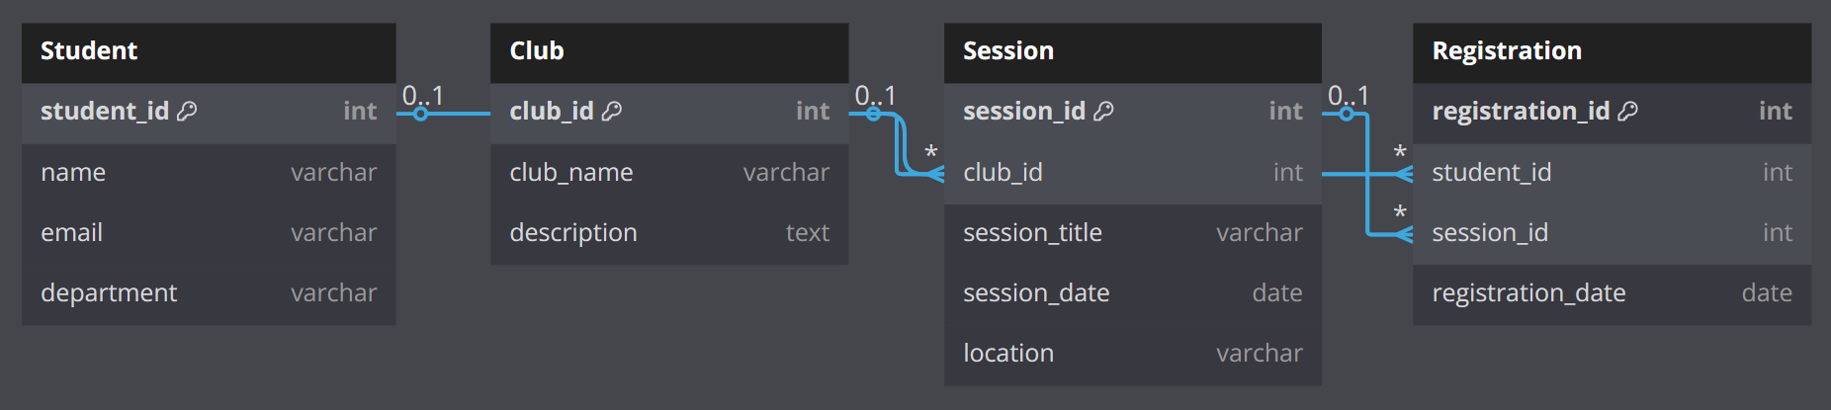
Entity-Relationship (ER) Diagram

Slide 7
Relational Schema
Student
student_id | INT | PK
name | VARCHAR(100) | NOT NULL
email | VARCHAR(100) | UNIQUE – NOT NULL
department | VARCHAR(50) | NOT NULL
Club
Column Name | Data Type | Key
club_id | INT | PK
club_name | VARCHAR(100) | NOT NULL
description | TEXT

Slide 8
Relational Schema
Session
Column Name | Data Type | Key
session_id | INT | PK
club_id | INT | FK → Club(club_id)
session_title | VARCHAR(100) | NOT NULL
session_date | DATE | NOT NULL
location | VARCHAR(100)

Slide 9
Relational Schema
Registration
Column Name | Data Type | Key
registration_id | INT | PK
student_id | INT | FK → Student(student_id)
session_id | INT | FK → Session(session_id)
registration_date | DATE | NOT NULL

Slide 10
Normalization

Slide 11
Normalization
What the database will looks like if we don’t use normalization?
The tables of our database will look like that: SOOO…
> This is called Unnormalized Form (UNF).
student_id | name | email | department | club_name | session_title | session_date
1 | Muhmedsadiq | example@gmail.com | Network Dept. | IT Students | SOC Introduction | 2025-05-01
…
…

Slide 12
Normalization
We need to organize our database to read, insert and modify the data as we like.
To do that we will use (1NF, 2NF and 3NF).
1st Normal Form (1NF)
- Each column should contain atomic (indivisible) values (Atomicity).
- Each row should have a unique identifier (Primary Key).

Slide 13
Normalization
We will make 4 tables each table will includes the data in a specific place.
We will have (Student, Club, Session and Registration table).
For example, Student table will look like that:
student_id (PK) | name | session_title | department | registration_date
1 | Ahmed Duraid | SOC Introduction | Network Engineering Dept. | 2025-04-28

Slide 14
Normalization
2nd Normal Form (2NF) – “Before that apply the 1NF”
Remove Partial Dependencies
1
student_id (PK) | name
1 | Ahmed Duraid
2
session_id (PK) | club_name | session_date
1 | IT Students | 2025-05-01

Slide 15
Normalization
3rd Normal Form (3NF) – “Before that apply 1NF & 2NF”
- Remove transitive dependencies.
session_id (PK) | session_title | club_id (FK) | session_date
1 | SOC Introduction | 1 | 2025-05-01

Slide 16
Queries & Operations

Slide 17
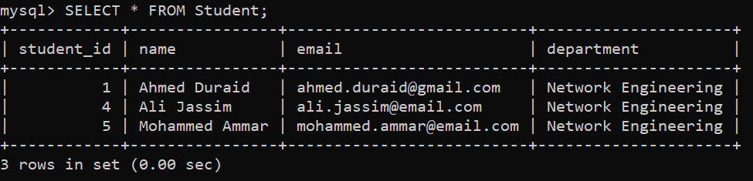
Queries & Operations
INSERT – Add a New Student
INSERT INTO Student (name, email, department)
VALUES (‘Ahmed Duraid’, ‘ahmedduraid@email.com', 'Computer Engineering');

Slide 18
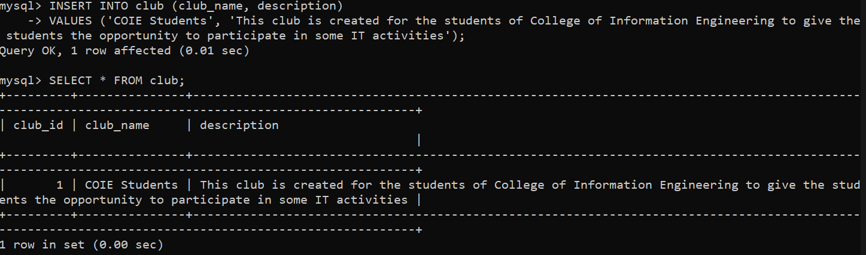
Queries & Operations

Slide 19
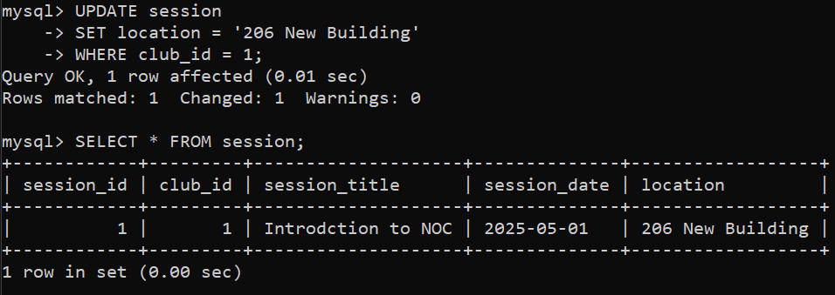
Queries & Operations
Update – Add a New Location to the Session

Slide 20
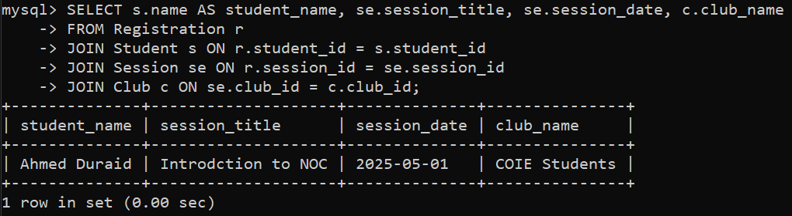
Queries & Operations
DELETE – Remove a Student’s Registration
SELECT & JOIN – List Students and Their Sessions
DELETE FROM Registration
WHERE registration_id = 5;

Slide 21
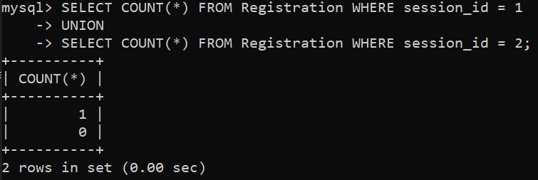
Queries & Operations
SELECT, COUNT & UNION – Show the Number of registers in the Sessions
There are a lot more of queries that will help use in this database, but this is enough to demonstrate the benefits of use SQL for our data.

Slide 22
Application Interface

Slide 23
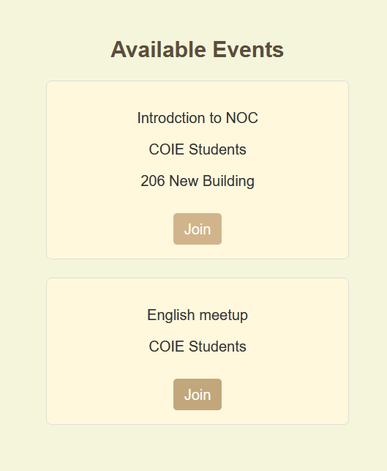
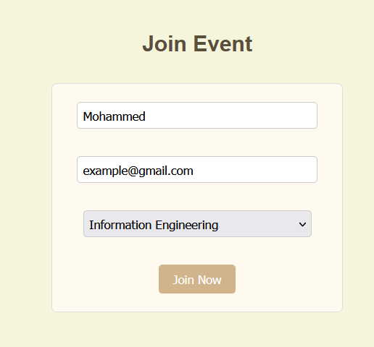

Application Interface
What users can do?

Slide 24
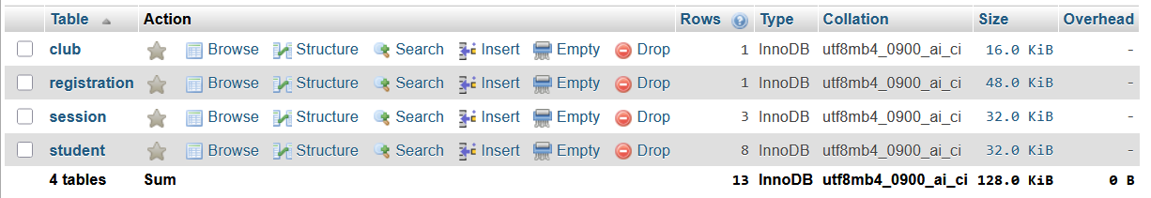
Application Interface
What we will have?

Slide 25

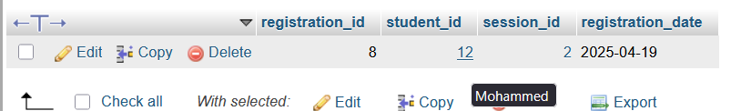
Application Interface
What we will have?

Slide 26
Challenges & Lessons Learned

Slide 27
Challenges & Lessons Learned
> Firstly I hate PHP very very very much especially when I used it at this project.
> Secondly when I created this project I learned all the basics that I want to have a great foundation in
Databases, and that is it.
Thanks :)

Slide 28
Q/A

Slide 29
THANKS 4 LISTENING

